Slide 1





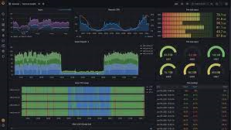
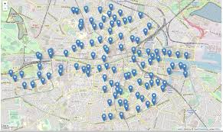

Kafka producer
Topic 1: raw_data
Data generator
100 user id + locations every 5 seconds
Topic 2: matches
Dynamic Visualization / Dashboard
www.grafana.com
Kafka consumer
Report,
Anonymize data & sell data
Message to user
Dynamic map visualization
www.leafletjs.com
Docker 1: Kafka + Zookeeper
Docker 2: PostgreSQL
Docker 3: Grafana

Slide 2
Kafka producer
Topic 1: raw_data
Data generator
100 user id + locations every 5 seconds
Topic 2: match
Dynamic Visualization / Dashboard
www.grafana.com
Kafka consumer
Report,
Anonymize data & sell data
Message to user
Dynamic map visualization
www.leafletjs.com

Slide 3

No
No match
DB SQL
Check match
Yes
Data generator
100 user id + locations every 2 seconds
Message to user
Visualization / Dashboard
Versión 2 NO
Kafka consumer

Slide 4


Kafka consumer
Match y no-match a Cassandra??
No
No match
Si
(Gestión) Mensajes??
Check match
Data generator
DB NoSQL
Message to user
Versión 1 NO
Visualization / Dashboard

